Slide 1
CPSO with Spatially Meaningful Neighbors
Peter Wilson
Supervisor: Professor Ombuki Berman
Notes:
Good Morning everyone! Thank you for coming to my presentation. I hope I’m able to teach you all something new as I discuss what I worked on over the year.
So, today I will be talking about the work and results I attained during the completion of my 4F90 with my supervisor Professor Ombuki.
The topic of this thesis is titled “CPSO with Spatially Meaningful Neighbors”, but don’t worry, I’ll go in depth about what that all means and how we got to the idea.

Slide 2
Topics
Breakdown on what that means
PSO
Spatially Meaningful Neighbors
CPSO
Experiments
Experiment Setup
Results
Breakdown
Conclusion
Future Research
Notes:
Here is a quick slide on what I will discuss today, starting with a breakdown of the topic. I’ll try to get as granular as possible. I’ll explain the idea by breaking it down into its parts and showing how we came up with the idea in hopes of forming some sort of narrative on how we landed on this idea for the thesis.
I will then go over the 2 experiments I conducted with this algorithm to see how this new twist to PSO stacks up against other versions.
Finally I’ll finish the presentation with some summarizing/concluding remarks as well as potential areas for future research.

Slide 3
What is PSO?
Notes:
So we’ll start at the root of the idea, PSO. What exactly is PSO?
Before I get into that, we can take a look at the slide. Here we have 2 instances of bird flocks moving around in nature. Now look at how these swarms move in big groups also in somewhat unison manner.
So, PSO (or Particle Swarm Optimization) is a problem optimization computational intelligence algorithm for optimizing continuous functions. This means it takes a problem with a various number of inputs an tries to find the optimal set of inputs in order to find the best potential output for the problem.
As I mentioned, PSO is a computational intelligence algorithm and like many computational intelligence algorithms, it models its actions based on behaviors found in nature. This brings me back to the images on the screen. In this case, PSO attempts to replicate the flocking patterns of birds or maybe more apropos for the name, the swarming tendencies of insects. As we can see on the screen, Birds tend to move in large groups. Also seen is that these groups are relatively spread out. When birds or insects are looking for food, they work as a team to find the best possible location. They take advantage of their numbers to examine a larger part of the land and communicate their findings to the group. Having the birds spread out gives the whole flock a better coverage of the land and therefore a better chance of finding the best spot. If one bird finds a good spot to land, it can notify the other birds and the can come around and follow.
Particle Swarm Optimization attempts to utilize this approach to instead examine the search space of a potential problem (finding the best output instead of landing spot) and returning the best value found in the group.

Slide 4
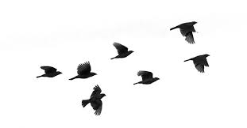
Follow The Leader
Leader
Velocity
Position
Notes:
So how does PSO go about implementing this behavior?
Well, if we take a closer look at this behaviour, a pretty common pattern can be recognized. The movements of the birds in the flock tend to match that of a “follow the leader” mentality. The birds in the flock will all approach the bird that is ‘leading the pack’ or in other words is seemingly heading toward the best result. If another bird finds a better area, that bird then becomes the leader and the flock will follow him.
So in implementing this in code, we need to visualize the individual birds in 3D space and designate attributes the birds will have that we can represent in code. We can note the birds movement in space can be represented with 2 main attributes. Those being the current position the bird is at (the x,y,z if you will), and the velocity the bird is moving which dictates both direction and speed. We can use those attributes almost directly in our algorithm implementation.

Slide 5

Global Best
1
Global Best
Particle
Actual Best
Personal
Best
Solutions
Notes:
Visualizing this implementation more would help if we could instead picture these birds as dots (or potential solutions) on a graph. These solutions we will refer to as ‘Particles”
Similar to the birds, the particles will have those position and a velocity attributes. In this case, the position will represent the input values we are inputting into our optimization problem.
In some cases, these will be a single value but a lot of times the optimization problems are more complex and require more inputs. The number of inputs add to the dimensionality of the problem.
This graph is a representation of a 2 dimensional problem that has 2 inputs (visibly represented on the x and y axis).
The velocity determines how that solution will alter for the next iteration. As it moves through the graph, the x and y values will change with that movement. The particle will update in the direction of the leader in hopes of finding a better solution along the way.
The individual positions would then need to be run through the function we are trying to optimize to find the particles ‘fitness’. Or how good that combination of inputs is compared to the other solutions in the swarm. Of the particles, the one in the group (or ‘swarm’) that has the best value is considered the ‘global best’ or current leader of the swarm.
This information gets passed to all the particles in the swarm and they will then begin to head towards this global best value.
As they are moving, their positions are constantly being tested against the fitness function. If a particle happens to find a better value along the way, it then becomes the leader.

Slide 6
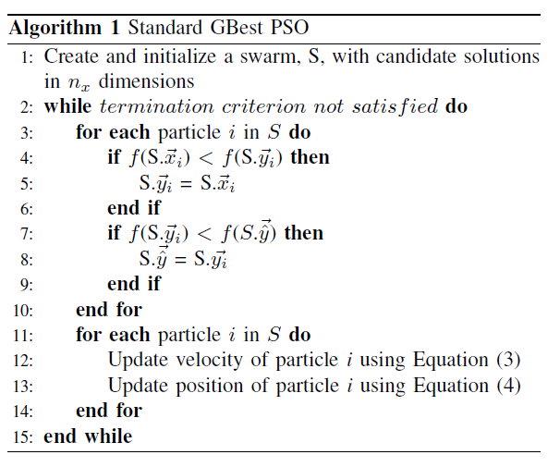
Algorithm
Notes:
So now that we’ve visualized what the algorithm needs to do, lets see that we need to accomplish this.
Here is a pseudocode implementation of the base PSO algorithm. As you can see, there isn’t much to it.
Going line by line, we can see we first initialize the swarm and randomize the positions of the initial particles. This ensures that they begin scattered throughout the search space.
We then loop through cycles where, for each particle, we run it’s current value through the fitness function to determine the fitness of it’s current position.
We then compare to see if that value is better than the particle’s personal best (or best value the individual particle has found up to this point, which we maintain as it will be used in determining future particle movements) and also see if it’s better than the overall global best (i.e. if it is becoming the new leader). It is important to update these prior to moving the particles each cycle since they both will effect the future movement of each particle in the swarm.
After updating these values we will then go through each particle and update both their velocity and position using this information. The process in which we determine the velocity of the particle is…

Slide 7

Update Velocity
Inertia component (ω) – influence of the previous computed velocity Random, stochastic component
Cognitive component (c1) – influence of the personal best position found (pbest )
Social component (c2) – influence of the swarm collective via the global best position found (gbest)
(r1,r2) – uniform random vectors with component values between 0 and 1
Notes:
This function.
This looks a little complicated but is much easier to understand when you break it down into it’s 3 components.
First is the inertia component. This dictates how much impact the current velocity has on the future velocity. Here, the current velocity is multiplied by a value that in many cases is defined prior to execution. Having a high inertia value will make each particle more resistant to new information and will have it less quickly adjust to the movements of the global best.
The Second Component is the cognitive component. This dictates how much the particles personal best value effects the velocity. Again, typically determined prior to execution, this will determine how willing the particle will venture into locally worse results to search the search space.
The Third component is known as the social component. This dictates how much pull the leader has and is also determined prior to execution. It typically requires a finely tuned balance of each variable to make the most out of this algorithm and studies have been attempted to discover optimal values for these variables.
Finally, since all the previous values are pre-determined, it makes sense to inject a bit of randomness to keep from converging to quickly. We do this by introducing a set of uniformly random vectors to continually change the influence of the social and cognitive components with each iteration.

Slide 8

Update Position
Notes:
As for updating the position of the particle, that is as simple as taking that newly computed velocity and adding it to the current position of the particle.

Slide 9
Follow The Leader
Leader
Notes:
Now, if you go back to the initial concept for the PSO, one thing you will notice is the only ‘social interaction’ between the particles in the swarm is from the leader to the rest of the swarm. ‘Non-leader’ particles have no way of sharing information between other particles. This is because there is an open channel amongst the swarm and the leader is able to force every particle to follow it.
This can lead to a more ‘naiive’ search as it is common for swarms to converge quickly to the global best without adequately searching the entire search space.

Slide 10

Neighbor Cooperation
Notes:
To combat this, a number of different techniques were tested to restrict the influence of the leader. This is done by specifically limiting which particle can talk to which. This layout is known as a Neighborhood Topologies. A number of different topology ideas have been put forth and tested with differing results.

Slide 11
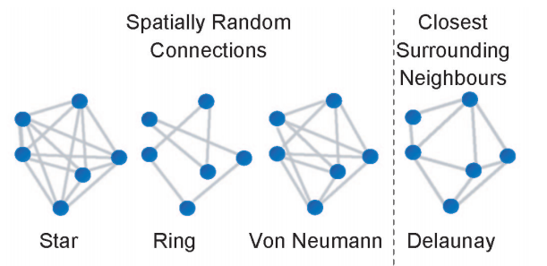
Neighborhood Topologies
Notes:
The following are a couple commonly used neighborhood topologies that have been studied.
We can see in these graphs that the particles are the dots and the connections connect the particles that they are able to communicate with. Communication refers to the group of particles if will look at for the leader. For instance, if the particle is only connected to 2 other particles, when it is updating it’s velocity, the ‘global best’ in the case of the particle would be the best value amongst itself and the 2 connected particles (as opposed to the best value in the whole swarm as previously mentioned)
The Standard PSO is referred to a using the ‘star’ topology. This allows all particles to talk to all particles and represents the quickest transfer of information in the swarm.
In an attempt to slow down the flow of information, the Ring topology was formed. This shrinks the connections to just 2 per particle and drastically reduces the flow of information. This in turn leads to much more exploration of the search space but as a result takes a longer time to converge on a solution.
A sortof hybrid of the 2 is the von-neumann topology. Here the Particles are connected to 4 particles. It is represented as 1 particle above, below, left and right, however this often refers more to the location of the particles in the array as opposed to being determined by the actual location of the particle.
All these topologies, are established at the beginning of execution and never changed. This means they are unable to utilize any metric pulled from information gathered by the swarm.

Slide 12
PSO Using Spatially Meaningful Neighbors
Particle Swarm Optimization with Spatially Meaningful Neighbours
James Lane, Andries Engelbrecht and James Gain
Notes:
As a result, Lane, Engelbracht and Gain introduced a new Topology called ‘Spatially Meaningful Neighbors’ in their paper “Particle Swarm Optimization with Spatially Meaningful Neighbours”. Instead of being static, this topology is dynamic, meaning it updates after every iteration. As a result, we are now able to use information from the swarm to dictate communication connections. Here, they decided it would be a worthwhile experiment to connect particles with their closest neighbors in the search space.
The idea behind this is that close particles have a high probability to search the same subspace (this is known as pockets in the search space that has it’s own local optima that may be the overall best value). By taking advantage of this information, we could potentially create more intelligent particles that work together as a team to search the space rather than just blindly converging on the first good solution it found.
Additionally, they found that if they utilized the Delaunay Triangulation algorithm, they were quickly able to establish this distance based connections. In their tests on small problems, they noticed it was able to easily connect the particles in each cycle without a significant impact on the runtime of the algorithm.

Slide 13
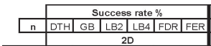
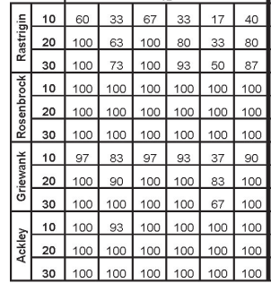
Results
Notes:
Additionally, they found that it was significantly more successful in finding optimal solutions compared to the other neighborhood topologies. Using the distance of the particles allowed the Swarm to better search the search space (as hypothesized) as particles in the same general area were able to work together and more thoroughly examine the local space. For lower dimension problems, this appears to be a great tool to maximize the success of your PSO algorithm.

Slide 14
Problem
Delaunay Triangulation in 2D
O(nlogn)
Delaunay Triangulation in 4D+
O(n^{[d/2]+1})
Notes:
However, they realized there was a caveat to this discovery. That caveat being that Delaunay Triangulation (or any triangulation algorithm for that matter) becomes increasingly difficult to compute in higher dimensions. This is because as the dimensions increase, the search space increases exponentially. This throws far too many variables and calculations into the mix which greatly increases complexity.
As we can see, for 2 dimensions the algorithm runs at a speedy O(nlogn), however, in 4+ dimensions that becomes O(n^[d/2]+1), making it exponential. This can take an excessive amount of time to compute on high dimensions and diminishes the potential benefits of the algorithm.
They concluded that the algorithm is perfectly fine to use in 2, 3 and possibly 4 dimensional problems, however becomes increasingly less useful as the dimensions increase

Slide 15
PSO
Global Best
Particle
Solutions
Notes:
If we return to this graph we can see the effect dimensionality has on PSO, this PSO is optimizing two variables (x and y) and is therefore, a 2 dimensional problem. Increasing the number a variables or inputs in the problems increases the dimensionality of the problem. But as we can see, this increase of dimensionality doesn’t just effect the difficulty to calculate the Delaunay Triangulation, it also increases the difficulty of the PSO itself.
As the dimensions increase, so does the size of the search space (exponentially so). Thankfully, some research has been conducted to solve this problem for PSO that we can also take advantage of to solve our problem with Delaunay Triangulation.

Slide 16
Solution
CPSO
A Cooperative Approach to Particle Swarm Optimization
Bergh and Engelbrecht
Notes:
This solution is known as CPSO, or Cooperate Particle Swarm Operation. Like Delaunay Triangulation, PSO too struggles with high dimension problems.
CPSO combats this issue by, instead of tackling the entire problem as a whole, it divides it up into a number of smaller problems and solve those individually with their own swarm. For example, if your problem has 6 inputs, CPSO can have one PSO optimize 3 of those inputs and a different PSO solve the remaining inputs.
It then will merge the values and return the individually optimal values as the final optimal solution. This essentially allows you to solve very high dimension problems using nothing but low dimension swarms.

Slide 17

CPSO using spatially meaningful Neighbors
Notes:
And finally, all this setup brings us to the topic of my thesis. By combining the power of Cooperative Particle Swarm Optimization with the established success of spatially meaningful neighbors, we can essentially have our cake and eat it to. This is because we are able to divide high dimension problems into a number of 2 or 3 dimension problems which in turn, better helps us make use of the benefits that Delaunay Triangulation gives.
This will allow us to expand this Spatially Meaningful Neighbor finding to a larger number of problems and ultimately make the new topology more useful.

Slide 18
The Experiments
Notes:
Now, if I havent thoroughly bored you all already, I think its time to get right into our experiments.
2 experiements were run, the first testing the new topology on the CPSO algorithm in lower dimension problems and the second, we scale up the dimensions of the

Slide 19
CPSO Variants
Algorithm | Description
PSO | For comparison’s sake, all CPSO variants will be compared to the standard PSO algorithm to ensure either of the changes lead to a meaningful beneﬁt. All the values will be identical to their CPSO counterparts.
CPSO-S | This variant restricts each swarm to just one dimension. It solves all dimensions dependently of each other. In problems of a single dimension, the distances are easily calculated directly instead of using the Delaunay Triangulation algorithm. This is due to Delaunay Triangulation not working for problems under 2 dimensions.
CPSO-Sk | Due to Delaunay Triangulation being limited to just 2 and 3 dimensions, a k needed to be selected in which the swarm is divided into 2 or 3 dimension chunks. For the purposes of this test, swarms were divided as such that each swarm solves 2 dimensions. (k = dimensions/2)
CPSO-Rk | The Algorithm was altered to ensure all the random swarms are selected to only be between 1 and 3 dimensions to ensure the spatially signiﬁcant neighbors algorithm works. The number of swarms is set to half that of the overall dimensions to allow for an even distribution of 1 dimension and 3 dimensional swarms.
Notes:
A number of PSO and CPSO variants were tested in the application of the experiments. As a baseline, the standard PSO algorithm was run to show the difference that both the CPSO and the new topology have on execution. From there, 3 CPSO variants were tested both with the new topology and without to see the benefit of the topology on the PSO type.
The first variant is CPSO-S. This was the first proposed CPSO algorithm and is as a result the most trivial. The idea here is to divide an n-dimensional problem instead into n, 1 dimensional problems. This runs off the idea that 1 dimensional problems are incredibly trivial to optimize using PSO. In this case, for the Spatially Meaningful neighbors, Delaunay Triangulation was not required to locate close particles. Since it is 1 dimension, the algorithm wouldn’t work. Therefore, particles were instead connected to the closest particle above and below itself.
This division into 1 dimension problems has an inherent issue, though. This is because it completely ignores the dimension dependencies that exists in the original problem. By splitting it up, we are removing these connections. To ensure the connections remain consistent. CPSO-Sk and CPSO-Rk were introduced. CPSO-Sk, instead divides the swarm into k evenly sized swarms. This attempts to group dependent dimensions. Additionally, CPSO-Rk expands on that by randomly dividing the swarms into k subswarms. This means the individual subswarms are different sizes and randomly solves a different portion of the problem.
To stay true to the main idea of this combination, steps were included to ensure the swarm sizes never exceeded 3 dimensions. This means CPSO-Sk would never have a k < dimensions/3 and CPSO-Rk would never choose a random number > 3.

Slide 20
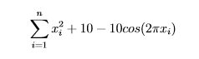
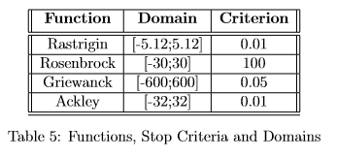
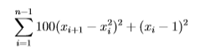
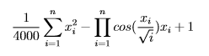
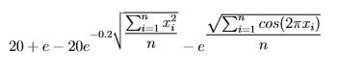
Tests
Rastrigin:
Rosenbrock:
Griewanck:
Ackley:
Notes:
In order to have a more structured test, steps were taken to match the testing benchmarks used in both the CPSO paper as well as the PSO with spatially meaningful neighbors. Thankfully, both paper used identical fitness functions and very similar testing measures.
In this case, the 4 testing functions are Rastrigin, Rosenbrock, Griewanck, and Ackley. All these functions support n-dimensions and are commonly used optimization functions. Additionally, consistent with the previous papers, these functions are clamped at their domain. This means Particles will not randomly generate outside of these pre-defined clamps as well as are restricted from moving outside. Additionally, a criterion has been set for each fitness function. This is a cutoff point at which a run is considered successful. The results are close enough to the optimal solution that we could deem the run is successful.
Again, all these values are consistent with both papers in an attempt to mirror the tests conducted previously.

Slide 21
Experimental Setup
Property | Value
Social Weight (λ) | 1.49
Cognitive Weight (ω) | 1.49
Inertial Weight (α) | starts at 1 and linearly decreases with each iteration, ultimately hitting 0 on the last iteration
Max Velocity (Vmax) | clamped to the domain of the function
Max Position (Pmax) | also clamped to the domain of the function
Particle Count | particles are evenly distributed among the swarms in the algorithm. for example, if the particle count is set to 100 and the CPSO has 10 diﬀerent swarms, each swarm will only have 10 particles to solve its particular subproblem
Notes:
And here is the parameter setup for all versions of the PSO. These are consistent across all PSO and CPSO variants. Here the Social weight and cognitive weight are defaulted to 1.49. Additionally, the Inertial weight is set to linearly decrease over the course of the run. This is set in that the inertial weight starts at 1 and decreases by the percentage of runs completed.
As mentioned previously, the max velocity and positions are clamped to the domain so the particles cannot exit these domains.
Now we have the particle count. Since the metric being used is the number of iterations required to solve the problem, it was imperative for there to be an equivalent amount of work allotted for each variant for each iteration. Having one perform 10 times the work each iteration would obviously lead to better results and therefore would make the comparison meaningless. As a result, the idea was used to divide the allotted particles amongst all swarms in the test. Each test has it’s own particle count allotment but this ensures that each iteration will have the identical number of particle evaluations regardless of the swarms. This also required for a minimum of n particles, or the number of particles equivalent to the number of dimensions. This is because CPSO-S divides the problem into 1-dimension swarms and each swarm requires at least a single particle.

Slide 22
Experiment 1: Low Dimension
6 dimension
50 runs
MaxIterations = 10,000
15, 20 and 25 particles
Robustness Tested
Percentage of Successes in the 50 runs
Average Iterations for Success
Notes:
So for the first test, we will see if the new topology has an effect on the outcome in a lower dimension problem. 6 dimensions was selected since it was low enough to not cause a significant problem for the other algorithms but large enough that performing Delaunay Triangulation directly would be difficult to compute.
In line with the other papers, 50 runs were completed and the averages of those runs were compared.
Multiple runs were also conducted with 15, 20 and 25 particles to see the increase in particles has on the execution.
And as for the comparison itself, the metric studied was the algorithm’s Robustness. In this case, we mean the success rate of those 50 runs as well as the average iterations to succeed within those runs. It should be noted that only successful runs are counted towards the average iterations metric. This is because all unsuccessful runs are 10,000 iterations and therefore would skew the results.

Slide 23
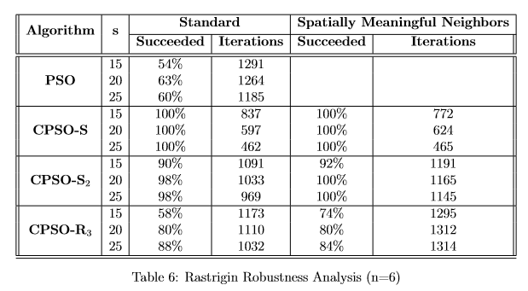
Results
Notes:
So here we have our run for the Rastrigin function. In this table, the first set of values represents the standard star topology while the second set of values on the right is those using the new spatially meaningful neighbors topology. As you can see, separate runs were conducted for 15, 20 and 25 particles
On both the CPSO-Sk and CPSO-Rk algorithms we see an increase in success rate in most cases. CPSO-S sees a consisted 2% increase through each run. While we see the largest increase for CPSO-R which jumps from 58% to 74%. It also interestingly sees a slight dip in the 25 particle run which may potentially be due to randomness of variables.

Slide 24
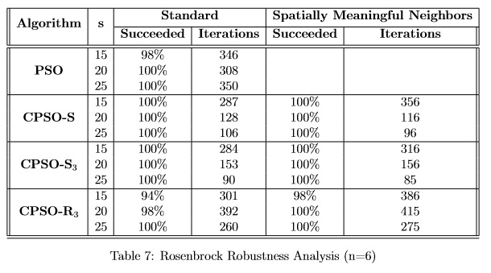
Results - Rosenbrock
Notes:
Moving on to the Rosenbrock algorithm we can see a pretty consistent 100% success rate. We can see the CPSO-Rk sees a consistent increase in success rate from the new topology on all particle runs.

Slide 25
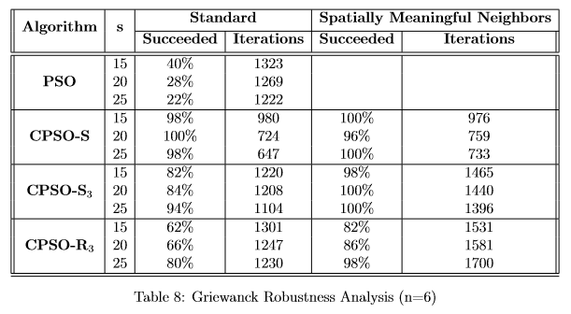
Results - Griewanck
Notes:
For the Griewanck function we see the largest boost for the new topology yet. CPSO-R sees a consistent 20% increase in success rate and CPSO-Sk is pretty consistently able to 100% while the star topology struggles to do so even in the higher particle runs.

Slide 26
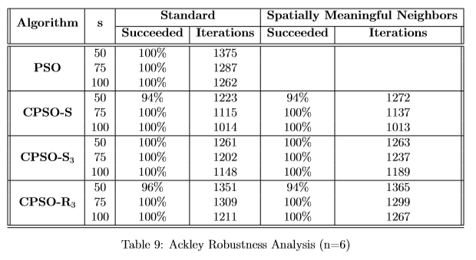
Results Ackley
Notes:
As for the Ackley function, it doesn’t really see any change. This may just be inherent in the function as the original engelbrect paper also noticed little benefit for this topology. It should be noted, CPSO-Rk experiences a single less success with the new algorithm but that could be a randomization problem.

Slide 27
Discussion
Function Specific Benefits
Griewanck, Rastrigin
No change in some cases
Never led to significantly worse results
Notes:
So some takeaways from this first experiment is that that the effect of the new topology very much depended on the function being tested. Some functions, such as Griewanch and Rastrigin experienced noticible boost in success rates while other functions achieved very similar results. This behaviour can be seen in the Engelbrect paper where Rosenbrock and Ackley had almost idential results for all topologies.
It should be noted, that apart from some small anomalies, the new topology never led to significantly worse result meaning it was either significantly better or the same.

Slide 28
Experiment 2: High Dimensions
20 dimension
50 runs
Max Iterations = 10,000
Particle count linearly increased with dimension size
50, 75, 100
Notes:
The second experiment tries to scale the problem up to a higher dimension to see if the benefit of the new topology still holds.
In this case we increased to 20 dimensions. The same number of runs and max iterations were used. The particles alotted to each algorithm was linearly increased to match the increase in dimension. This means runs with 50, 75 and 100 particles were tested.

Slide 29
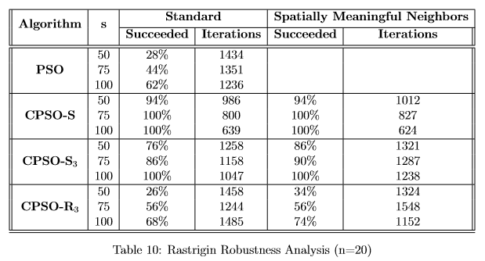
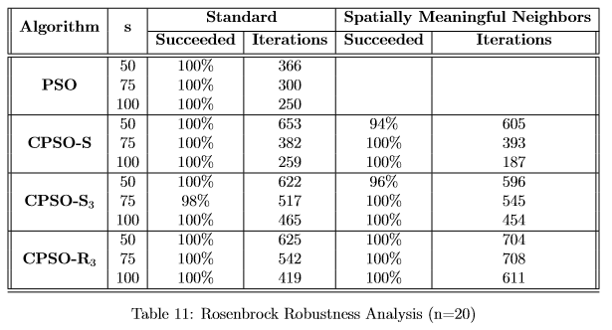
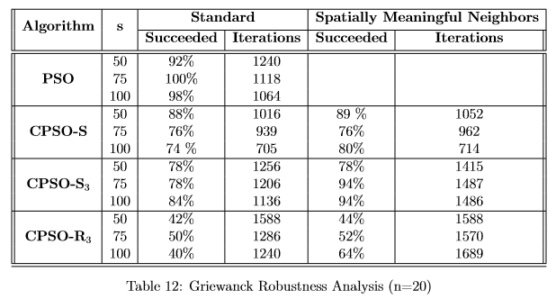
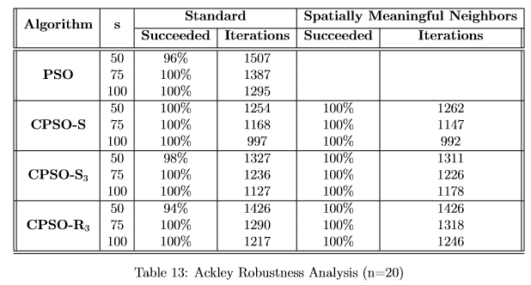
Results
Notes:
I’m going to quickly go over this since we can see the results are very similar to the previous set. This shows that the benefits do scale to higher dimensions proving that CPSO is able to bring this new topology to higher dimension problems.
Consistent with the previous run the tables on the left side (i.e. Rastrigin and Griewanck) see large boosts in success rate while the tables on the Right are pretty similar both with and without the new topology.
For the tables that there is a benefit, there is pretty consistently a 10-20% increase in success rate which is consistent with the previous experiment.

Slide 30
Conclusion
Successfully Expands into higher dimensions
Doesn’t work for all functions
Rarely leads to a worse result
Still slow
Problems inherent in CPSO
Notes:
This leads us to our conclusion. After the round of testing, we can see that CPSO does help us expand the Spatially Meaningful Neighbor topology to higher dimensions and still see the benefits that come from the new topology, however the benefits it offers vary based on the function at hand though it rarely leads to a bad result.
It should be noted that adding Delaunay Triangulation increased the execution time of the algorithm quite a bit. Especially on the high dimension problems where a triangulation needed to be computed for each swarm on each iteration. Might be worth looking into maybe decreasing the frequency of the calculation. Unless the particles are very close to each other, it is unlikely for the topology to have to change drastically each iteration. It may be worth looking into calculating it only every other iteration or even less frequently.
Also, since we are introducing CPSO, it brings up the problems inherent with that algorithm that one should keep in mind. For high dimension/high variable dependency problems, this may not be the route to take as a standard PSO may be of more help.

Slide 31
Future Work
Look into different dynamic topologies
Different metrics
Other functions
Other variants
Notes:
As far as where this research could be taken., I believe we only scratched the tip of the iceberg as far as dynamic topologies go. Being able to build a topology based on information gathered by the swarm will allow us to more directly fine tune the movements of the particles. Creating new topologies based on different information or metrics could potentially be tested to better control the movement of particles and essentially make them smarter.
This work could also be tested against more/different optimization functions to see which functions offer the best benefit
Additionally, there are a number of other CPSO variants that offer something different. Tests should be done with the new topology on the more complicated variants to see if the benefits continue on.

Slide 32
References
[1] J. Blackwell R. Kennedy. Particle swarm optimization. Swarm Itelligence, 1:33–57.
[2] Andries Engelbrecht James Lane and James Gain. Particle swarm optimization with spatially meaningful neighbours. Swarm Intelligence Symposium, September 2008.
[3] Mu˜noz Zavala Angel Eduardo. A comparison study of pso neighborhoods. EVOLVE - A Bridge between Probability, Set Oriented Numerics, and Evolutionary Computation II, 175:251–265.
[4] Gjacquenot. Delaunay circumcircles vectorial. [Online; accessed May 3 2016].
[5] Jose Gabriel Ramires-Torres Angelina Jane Reyes Medina, Gregorio Toscano Pulido. A comparative study of neighborhood topologies for particle swarm optimizers.
[6] D. T. Lee and B. J. Schachter. Two algorithms for constructing a delaunay triangulation. International Journal of Computer and Information Sciences, 9:219–242.
[7] F. Van den Bergh and A.P. Engelbrecht. A cooperative approach to particle swarm optimization. IEEE Transactions on Evolutionary Computation, page 225–239, June 2004.
[8] Alan Mackworth David Poole and Randy Goebel. Computational Intelligence: A Logical Approach. Oxford University Press, 19986.
[9] Magnus Erik Hvass Pedersen. Good parameters for particle swarm optimization.
[10] Justin Maltese. Vector-evaluated particle swarm optimization using co-operative swarms. 3F90 Thesis, 2014.
[11] Hanning Chen Tao Ku Wenping Zou, Yunlong Zhu. Clustering approach based on von neumann topology artiﬁcial bee colony algorithm.
[12] Lena Schlipf Panos Giannopoulos, Wolfgang Mulzer. Computational geometry: Polygon triangulation.
[13] M.A. Potter and K. A. de Jong. A cooperative coevolutionary approach to function optimization. The Third Parallel Problem Solving From Nature.

